Slide 1



Fine-grained Image Classification
Yasser Souri
Supervisor:
Prof. Shohreh Kasaei
Image Processing Lab
Computer Engineering Department
Sharif University of Technology

Slide 2
Outline
Introduction
Review
Image Classification
Fine-grained Image Classification
Baseline Methods
Experimental Analysis
Future Work

Slide 3
Outline
Introduction
Review
Image Classification
Fine-grained Image Classification
Baseline Methods
Experimental Analysis
Future Work

Slide 4
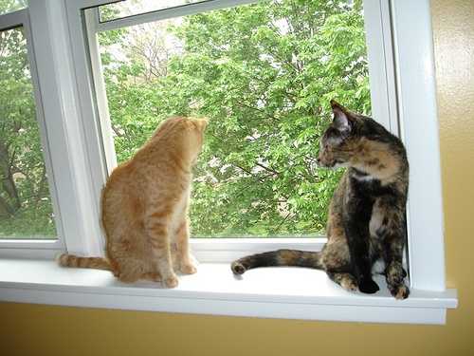
Image Classification
Notes:
Given a set of classes, and an image

Slide 5
Image Classification
Notes:
The task of “Image Classification” is to tell whether an object belonging to each of the classes is present in the image.

Slide 6
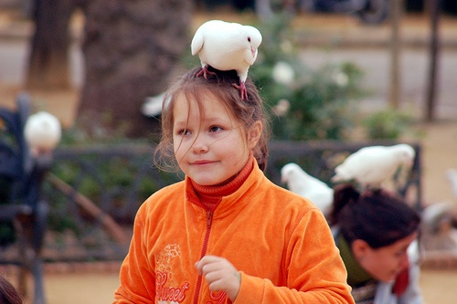
Image Classification
Notes:
There could be multiple objects in the picture

Slide 7
Image Classification
Notes:
There could be multiple objects in the picture

Slide 8








Fine-grained Image Classification
Image classification, when considered classes are all subclasses of a certain class
They are similar in appearance

Slide 9
Outline
Introduction
Review
Image Classification
Fine-grained Image Classification
Baseline Methods
Experimental Analysis
Future Work

Slide 10
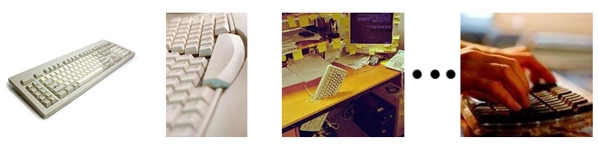
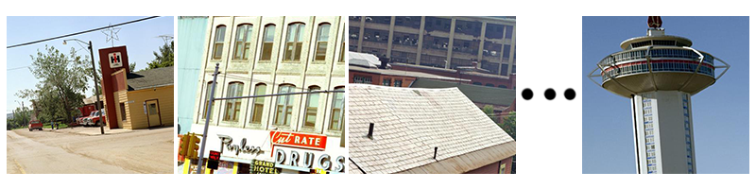
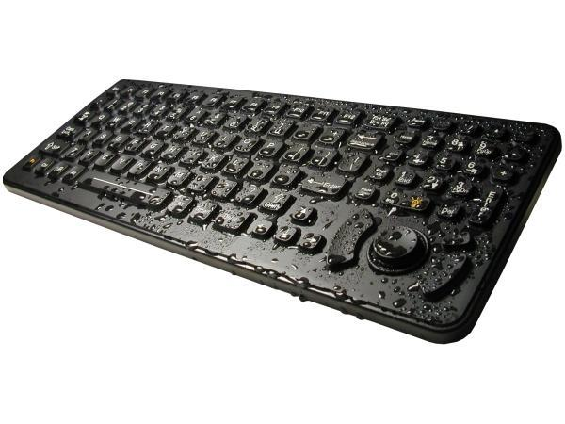
Image Classification Training/Testing
Given
Positive training images containing an object class
Negative training images not containing that object class
Classify a test image whether it contains the object class

Slide 11
Image Classification Systems
Vocabulary Based Methods
Deep Learning Methods

Slide 12
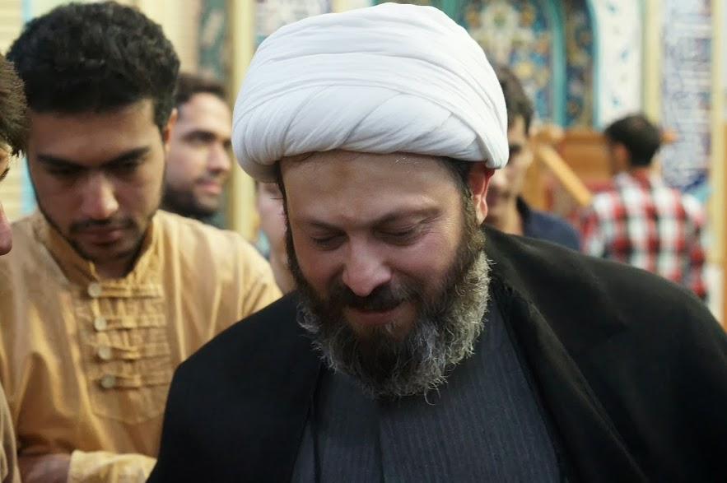
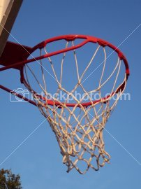
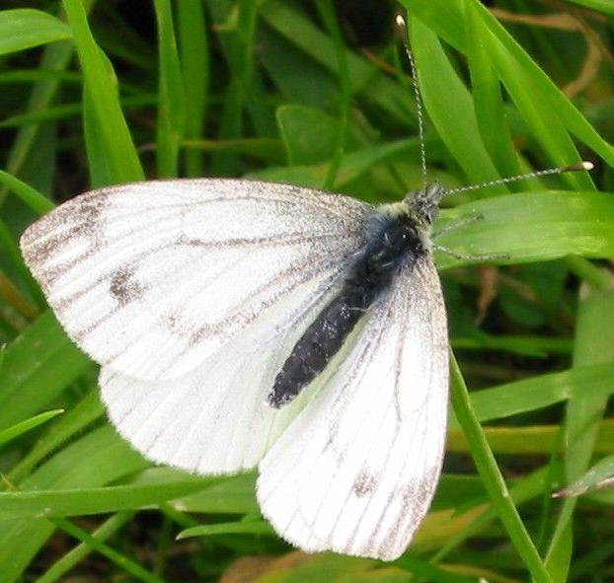
Vocabulary Based Methods
Building the Vocabulary
…
Notes:
The center of the clustering is the vocabulary itself

Slide 13
Vocabulary Based Methods
Bag of words
Feature Extraction
Coding
Pooling
Average pooling: Average of the codes
Using keypoint detection methods like Harris-Affine or densely
Using descriptors like SIFT
Using the Vocabulary and vector quantizations methods like KMeans

Slide 14
Vocabulary Based Methods
Spatial Pyramid Matching
Coding
Pooling
Concatenating
Sub-regions
Pooling

Slide 15
Vocabulary Based Methods
Overview
Feature Extraction
Coding
Pooling
Concatenating
Notes:
Different coding is the main difference of vocabulary based methods

Slide 16
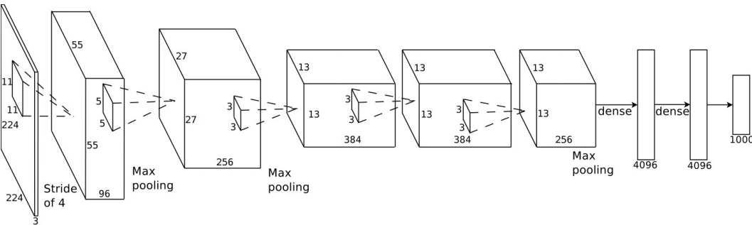
Deep Learning Methods
Network architecture
Trained with 1.2 million images

Slide 17
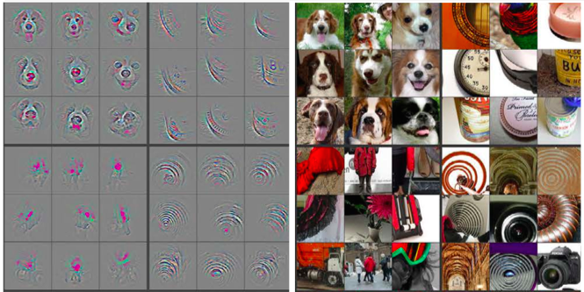
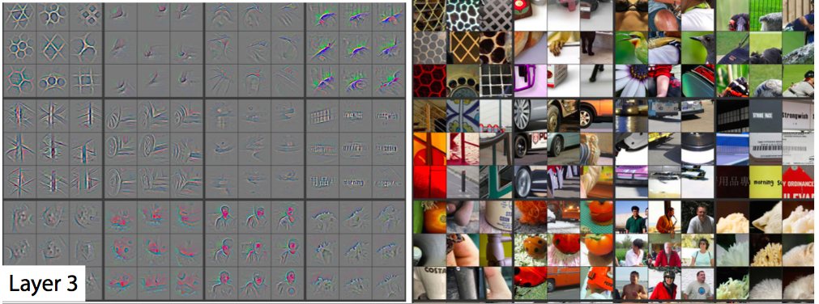
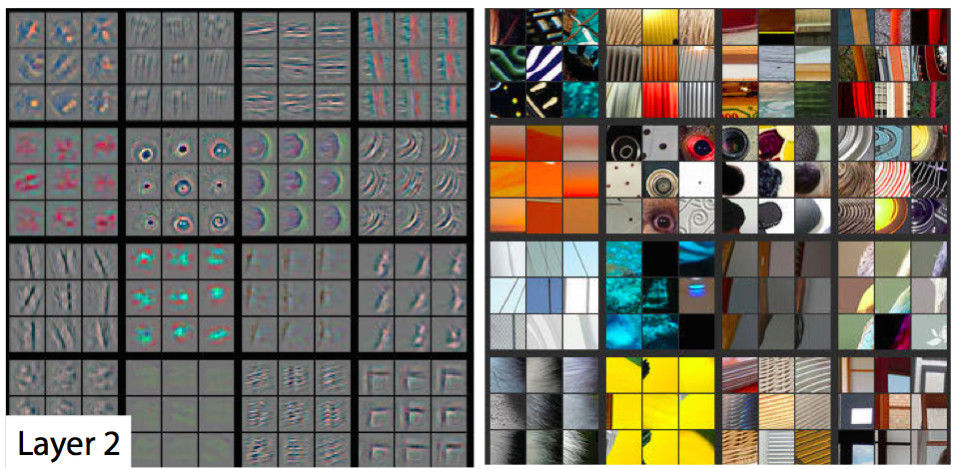
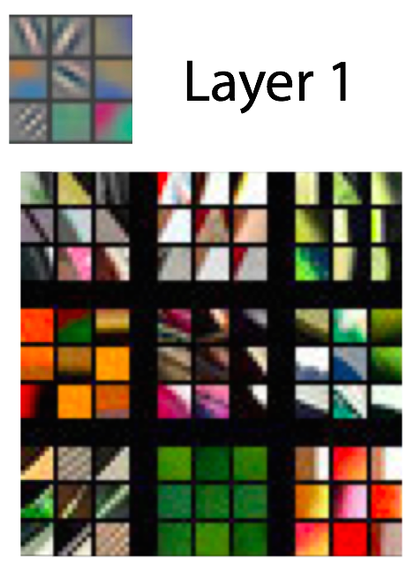
Deep Learning Methods
Learned Features

Slide 18
Deep Learning Methods
Feature engineering vs. feature learning
Results of Pascal VOC 2007 [47, 23]
Method | mAP
SIFT + VQ + SVM | 46.54
SIFT + LLC + SVM | 57.60
SIFT + FV + SVM | 61.69
CNN + SVM | 73.90

Slide 19
Outline
Introduction
Review
Image Classification
Fine-grained Image Classification
Baseline Methods
Experimental Analysis
Future Work

Slide 20
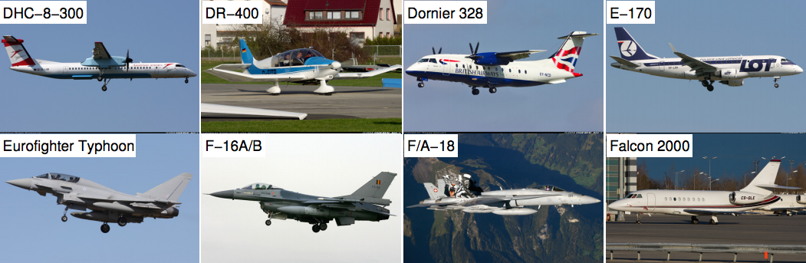
Fine-grained Datasets
Oxford Airplanes Dataset

Slide 21
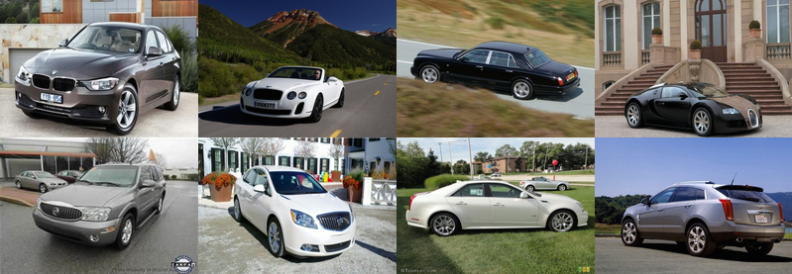
Fine-grained Datasets
Stanford Cars Dataset

Slide 22
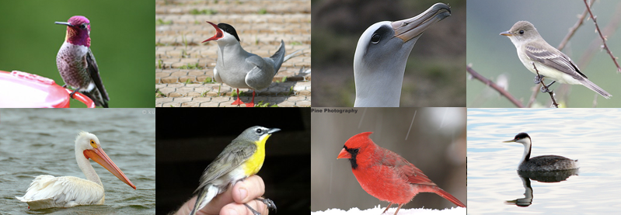
Fine-grained Datasets
Caltech UCSD Birds Dataset

Slide 23
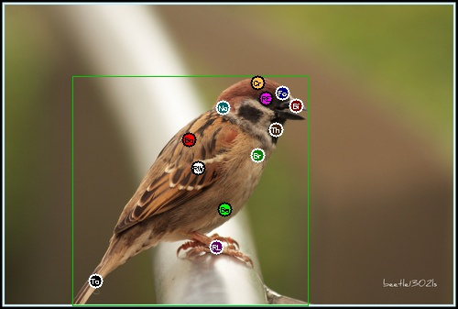
CUB Dataset Annotations

Slide 24
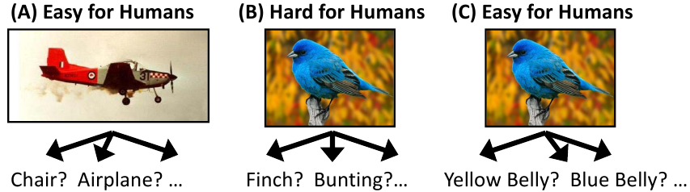
Fine-grained Classification Methods
Human In the Loop Methods

Slide 25
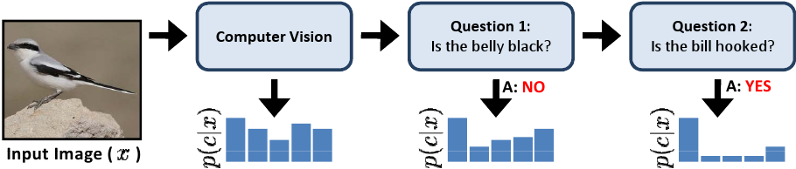
Fine-grained Classification Methods
Human In the Loop Methods
CUB-2011 Accuracy [38]
0 Q : 19%
20 Q: 50%
Not fully automatic

Slide 26
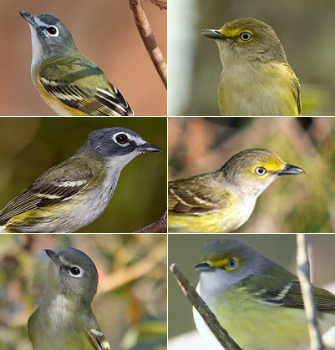
Fine-grained Classification Methods
Discriminative parts are important

Slide 27
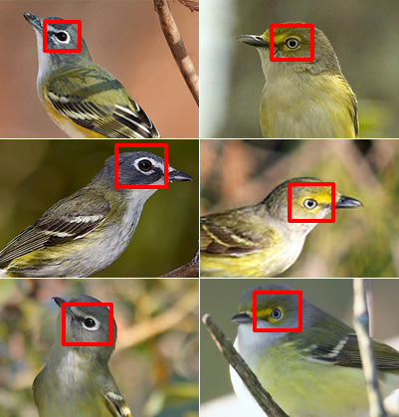
Fine-grained Classification Methods
Discriminative parts are important

Slide 28
Finding Discriminative Parts
Is Hard and Computationally expensive
Results in low accuracies
CUB-2011 Accuracy
41.01 % [41]

Slide 29
Fine-grained Classification Methods
Deep learning
Achieving great results
53.3 % [47]

Slide 30
Outline
Introduction
Review
Image Classification
Fine-grained Image Classification
Baseline Methods
Experimental Analysis
Future Work

Slide 31
Baseline Methods
Based on [47]
Use the network for features
Use Linear SVM for classification

Slide 32
Baseline Methods
Ours-1
Not using the bounding boxes
45.44 %
Ours-2
Cropping with bounding boxes
55.62 %
Ours-3
Ours-1 + Ours-2
57.83 %

Slide 33
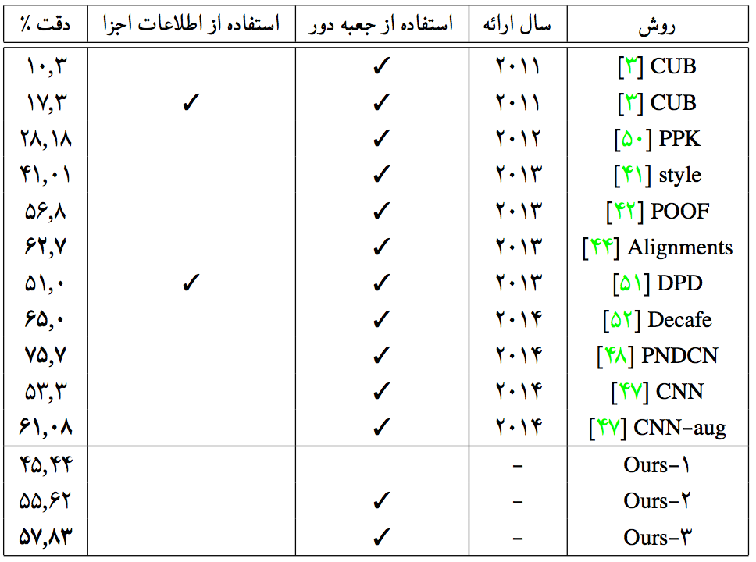
Comparison

Slide 34
Outline
Introduction
Review
Image Classification
Fine-grained Image Classification
Baseline Methods
Experimental Analysis
Future Work

Slide 35
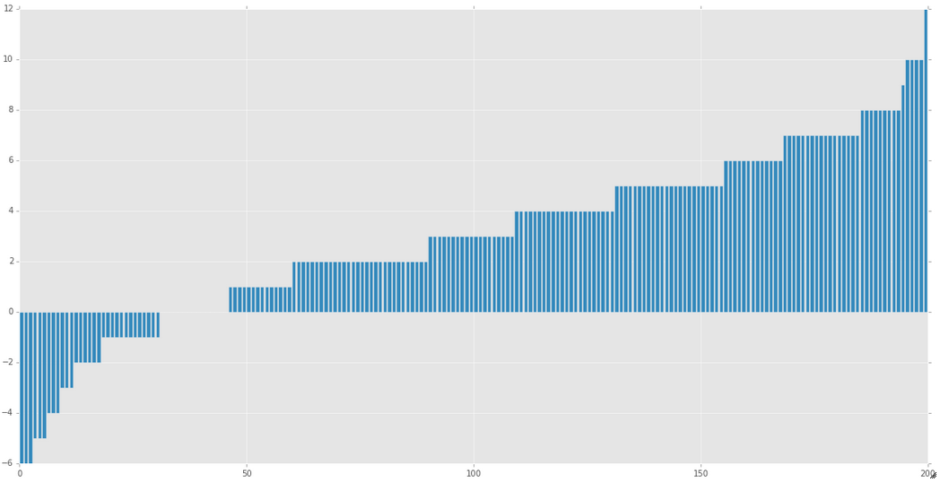
Experimental Analysis
Ours-4
Model averaging
58.00 %
Ours-2 vs. Ours-1 ( + 10.18 %)
Removing background helps

Slide 36
Experimental Analysis
Total Agreement in Our-1, Our-2, Our-3

Slide 37
Experimental Analysis
Total Agreement in Our-1, Our-2, Our-3
Agreement is 84 % correct

Slide 38
Outline
Introduction
Review
Image Classification
Fine-grained Image Classification
Baseline Methods
Experimental Analysis
Future Work

Slide 39
Future Work 1
Getting the same baseline methods on other datasets

Slide 40
Future Work 2
Using Part Annotation

Slide 41
Future Work 3
Finding the complementary model
Using mixture of experts

Slide 42
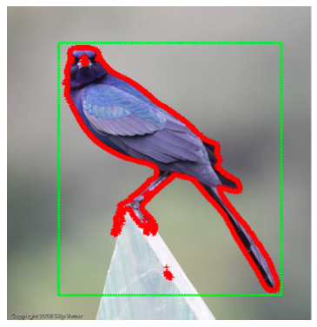
Future Work 4
Removing background even further with segmentation

Slide 43
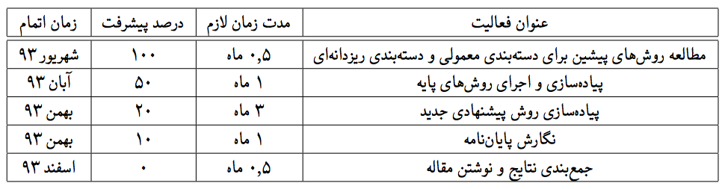
Future Work

Slide 44
Thank you
Summer 2014

Slide 45
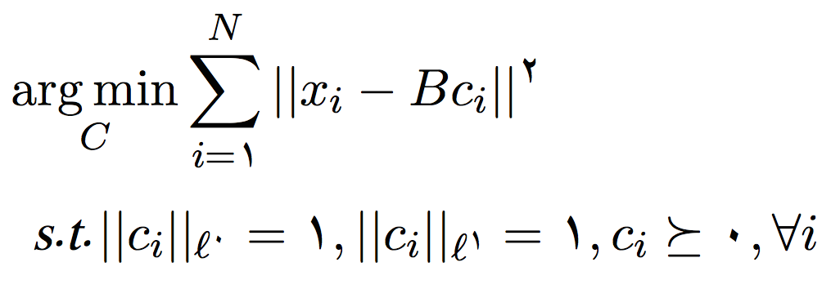
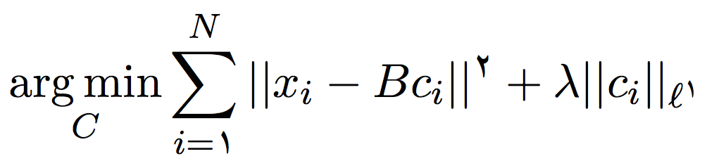
Vocabulary Based Methods
Coding: VQ
Coding: SC

Slide 46
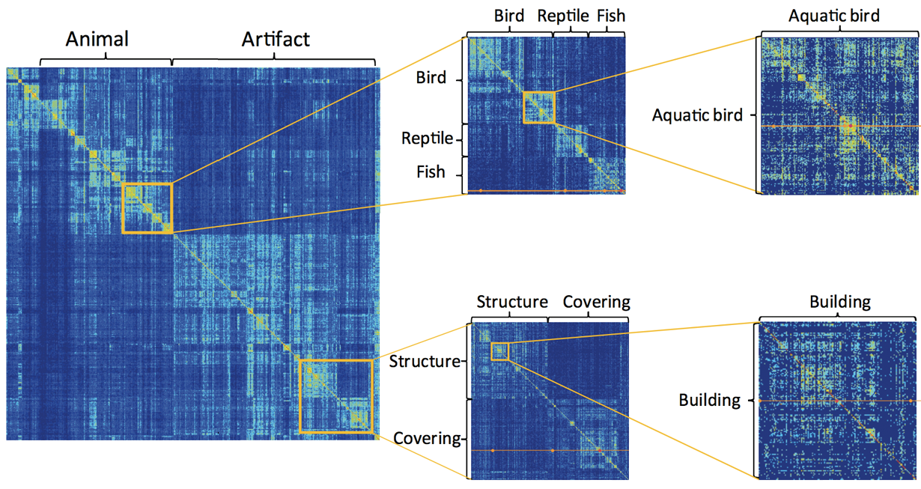
Image Classification Methods
Analysis

Slide 47
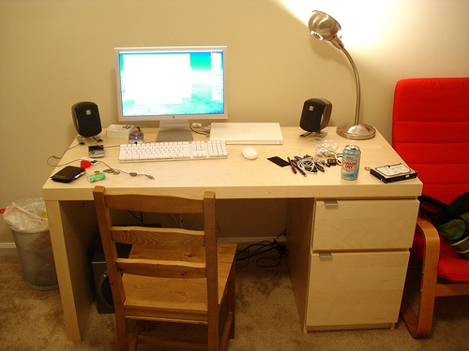
Image Classification
Notes:
There is no need to specify the location of the object in the image.

Slide 48
Image Classification
Notes:
There is no need to specify the location of the object in the image.

